Slide 1
Natural Language Generation

Slide 2
Natural Language Generation
This is the process of converting back representation to natural language.
It is the process of producing meaningful phrases and sentences in the form of natural language from some internal representation.

Slide 3
Natural Language Generation
Natural-language-generation systems convert information from computer databases into normal-text or sounding human language.

Slide 4
Definition 2: NLG
Natural Language Generation (NLG) is the natural language processing task of generating natural language from a machine representation system such as a knowledge base or a logical form.

Slide 5
NLG Included the Three Things
Text Planning: It include the extracting knowledge from knowledge base.
Computer will find the words from base
knowledge.
Sentence Planning: This Include selection of correct words and forming sentences which follow the grammar.

Slide 6
NLG Included the Three Things….
Text Realization: Mapping the planned Sentence in to reality.
Computer will check that did I speak it reality .

Slide 7
Ingredient or components of NLG
Goal:
  Computer software which produces understandable and appropriate texts in English or other human languages
Input:
  Some basic linguistic representation of information.
  The goal that the system has to satisfy (e.g inform the user)
Output:
  Documents, reports, explanations, help messages, and other kinds of texts
Knowledge sources required:
  Knowledge of target language (grammar, lexicon or words)
Notes:
7

Slide 8
Example system# 1 Forecast Generator or FoG
FoG is system that is developed by Environment Canada as a productivity aid for its meteorologists.
Forecasters use Fog graphical editor to modify a map showing barometric pressure, the location of fronts, and other data.

Slide 9
After modifying the map, the forecaster presses the "Generate" button, and FoG automatically generates a textual weather report for the area in both English and French.

Slide 10
Example System #1: FoG (Forecast Generator)
Function:
  Produces textual weather reports in English and French
Input:
  Graphical/numerical weather depiction or characteristics.
User:
  Environment Canada (Canadian Weather Service) (organization )
Developer:
  CoGenTex
Status:
  Fielded, in operational use since 1992

Slide 11
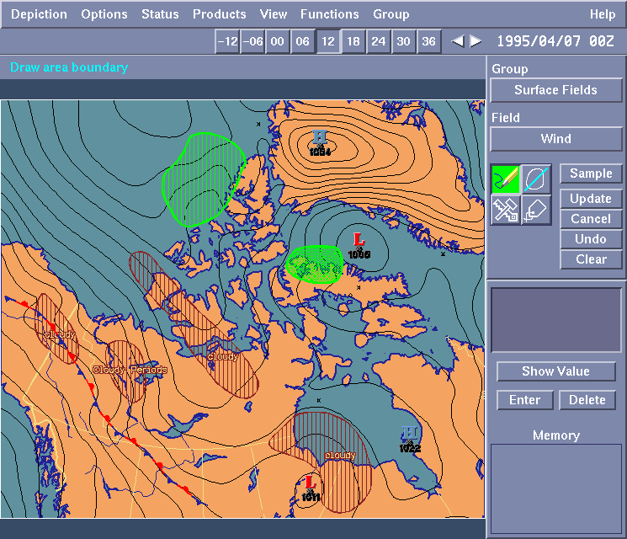
FoG: Input

Slide 12
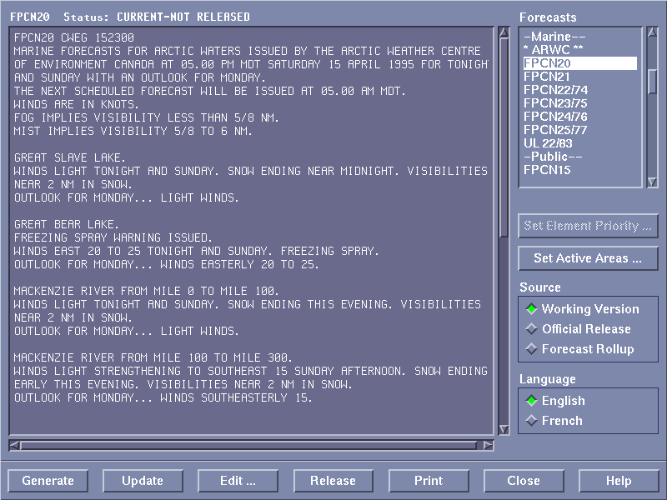
FoG: Output

Slide 13
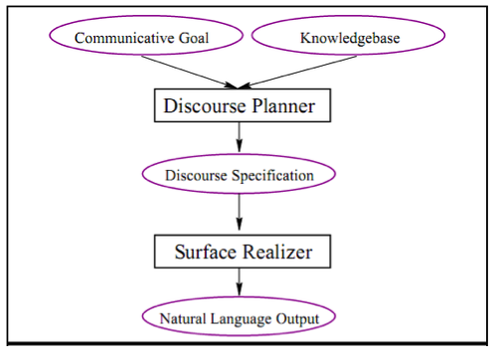
The architecture of NLG systems is presented in

Slide 14
This architecture contains two pipelined components:
Discourse Planner: The discourse planner will generate discourse plan by taking from the communicative goals and the available knowledge base.
This component starts with a communicative goal and makes all the choices (content selection, lexical selection, sentence structure, and discourse structure).
It selects the content from the knowledge base (complex structured and unstructured information used by a computer system) and then structures that content appropriately.
The discourse planner define the entire communication ( may span multiple sentences)

Slide 15
Surface Realizer(linearization according to grammar )
The surface realizer receive the fully specified discourse.
And then generate the sentences according to grammar.

Slide 16
The end

